Slide 1
Python Programming

Slide 2
Control Structures: Looping
Looping helps to execute set of statements multiple number of times.
Counter variable helps to count the number of times the loops get executed.
Example: Initialize session
Step 1. Students join the session If session <=12, go to Step 1.
Step 2. Faculty takes the session Else go to Step 6
Step 3. Provide demo programs Step 1. Students join the session
Step 4. Q&A discussion Step 2. Faculty takes the session
Step 3. Provide demo programs
Step 4. Q&A session Step 5.Increment session count, goto step0
Step 6: Conclude the course

Slide 3
Control Structures: Looping
Looping Statements
  while
  for
  while:
  Repeatedly executes a set of statements based on checking the boolean condition (expression).
  while syntax:
  while test_expression:
  while block

Slide 4
Looping: Factorial Calculation
# Factorial Calculation – N! = 1 * 2 * 3….* N
fact=1;i=1
n=int(input(“Enter a number”))
while i<=n:
fact = fact * i
i=i+1
print(“The factorial is “, fact);

Slide 5
Looping: Infinite Loop
n=1
while n<5:
print(n)
print(“Program is terminating”)
Note:
Careful when checking condition & incrementing / decrementing counter variable.

Slide 6
Looping: while….else
Syntax:
while condition:
stmts
else:
stmts
‘else’ will get executed when ‘while’ loop terminates normally.
‘else’ will not get executed when ‘while’ loop terminates abnormally. (during break)
Using ‘else’ is optional

Slide 7
Looping: while….else - Example
n=1
while n<5:
print(n)
n=n+1
else:
print(“Program is terminating”)
n=1
while n<5:
if n==3:
break
print(n)
n=n+1
else:
print(“Program is terminating”)

Slide 8
Looping: for
Syntax:
for counter_var in sequence or range:
stmts
Example 1:
for letter in ‘Python’:
print(“Current letter:”, letter)
Example 2:
for n in range(1,10):
print(n)

Slide 9
range function
Syntax:
range(begin,end,step)
begin: First value in the range, if omitted by default 0
end: Last value in the range, may not be omitted
step: increment / decrement, by default it is 1.
begin, end, step all should be integers

Slide 10
range function: Example
range(0,10,1)
range(10)
range(1,10)
range(1,10,2)
range(10,0,-1)
range(10,0,-2)
range(2,11,2)
range(-5,5)
range(1,2)
range(1,1)

Slide 11
Print Even Numbers using ‘for’
Program:
n=int(input())
for i in range (2,n,2)
print(i)

Slide 12
Factorial Program using ‘for’
# Factorial Calculation – N! = 1 * 2 * 3….* N
fact=1
n=int(input("Enter a number"))
for i in range(1,n+1):
fact = fact * i
print("The factorial is ", fact);

Slide 13
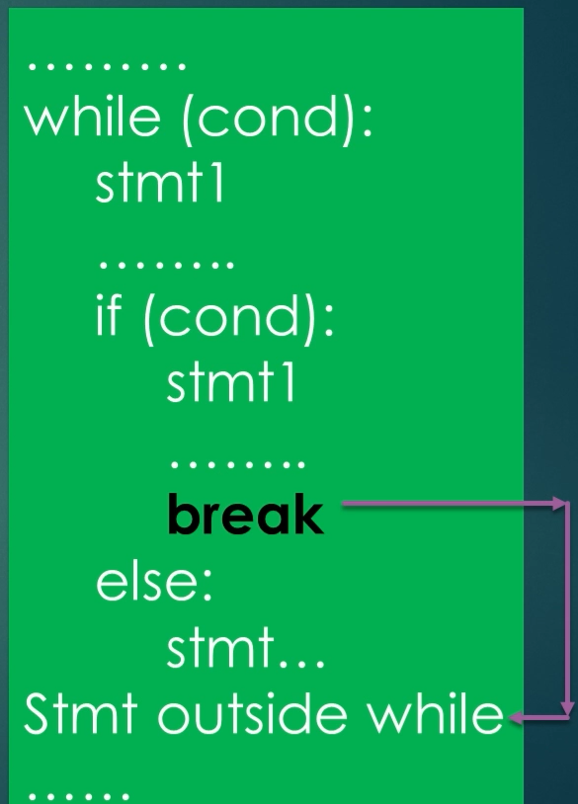
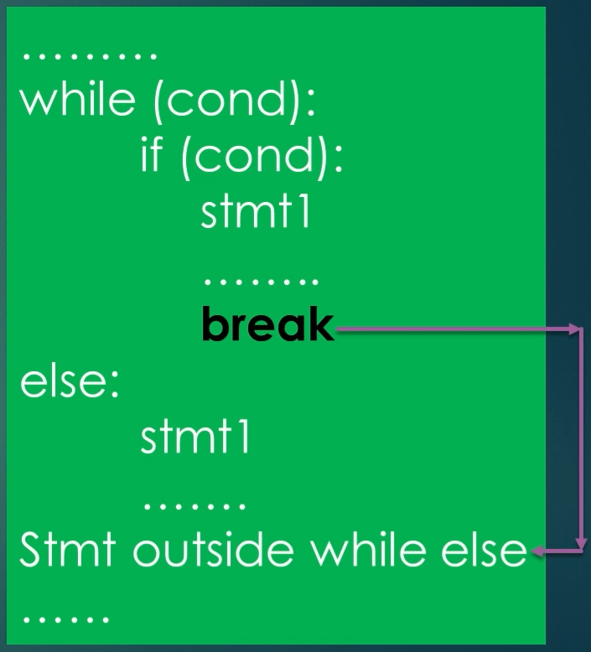
break and continue
‘break’ is always associated with ‘if’ statements inside looping statement
If ‘break’ encountered, control comes out of looping statement

Slide 14
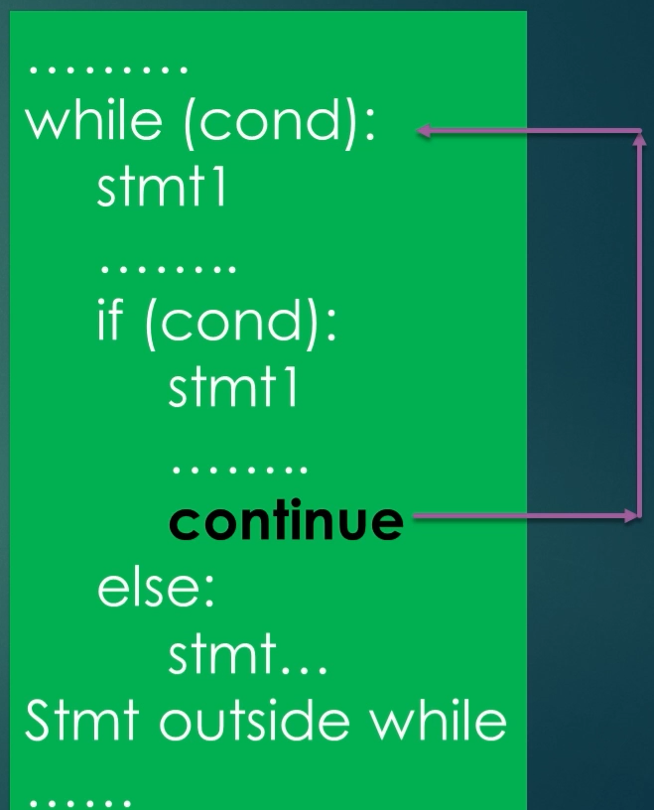
break and continue
‘continue’ is always associated with ‘if’ statements inside looping statement
If ‘continue’ encountered, control goes to while statement and checks the condition again (fresh iteration starts)

